Slide 1
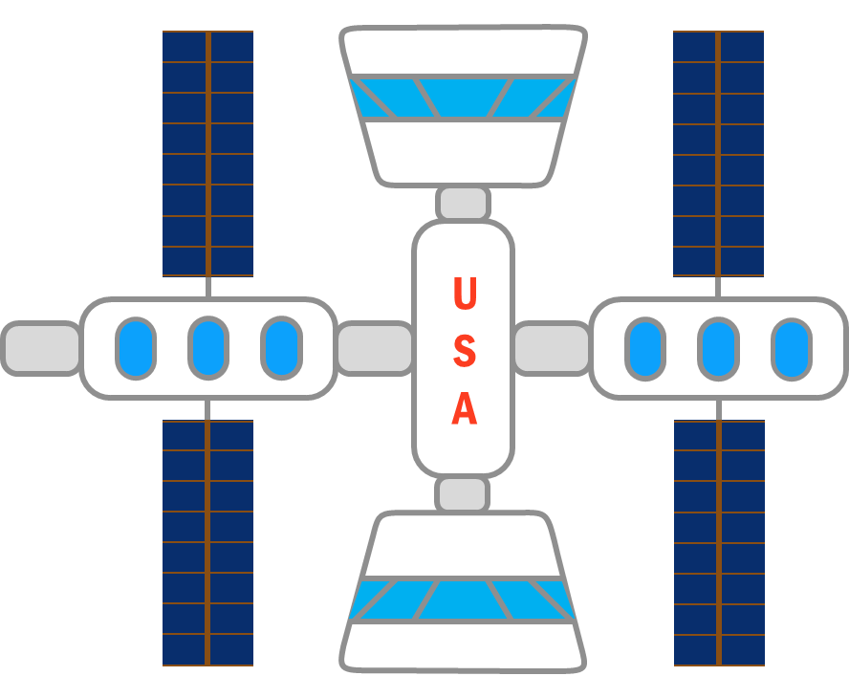
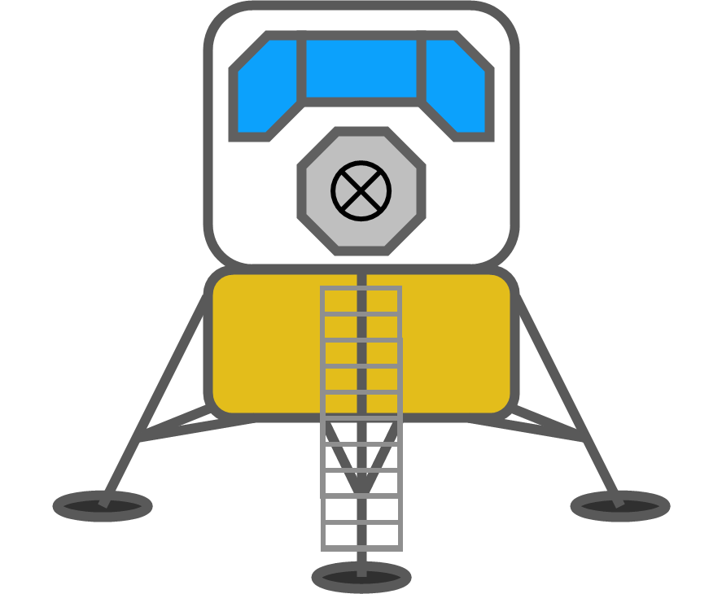
Reusable Shock Absorber for New Lunar Lander
Design Review 4
Team 515
January 26, 2021
1

Slide 2
Team Members
Team Members
Josh Blank
Design Engineer
Matt Fowler
Systems Engineer
Tristan Jenkins
Design Engineer
Alex Noll
Mechanical Engineer
Melanie Porter
Dynamics Engineer
Matt Fowler
2

Slide 3
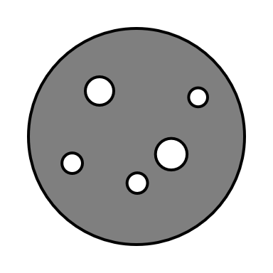
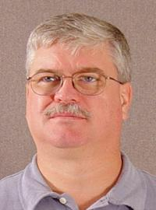
Sponsor & Advisor
Sponsor & Advisor
Project Sponsor
Rachel McCauley
MSFC Advanced Concepts Deputy Manager at NASA
Academic Advisor
Keith Larson
Teaching Faculty I
Matt Fowler

Slide 4
Objective
To design a reusable device for the human lander system that will dissipate the impact energy in such a way that it does not damage the vessel or occupants.
Matt Fowler

Slide 5
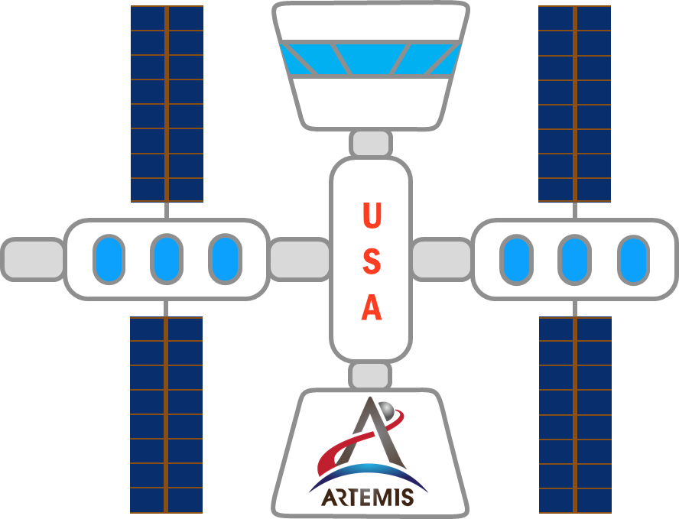
Project Description
Project Description
Matt Fowler

Slide 6
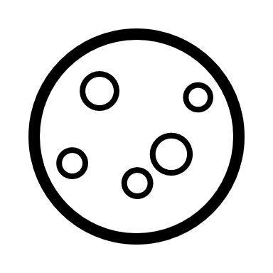
Functions
Previous Work
#1
Project Scope
Customer Needs
Background Research
Functional Decomp
Targets & Metrics
Concept Generation
Concept Selection
Link
Matt Fowler

Slide 7
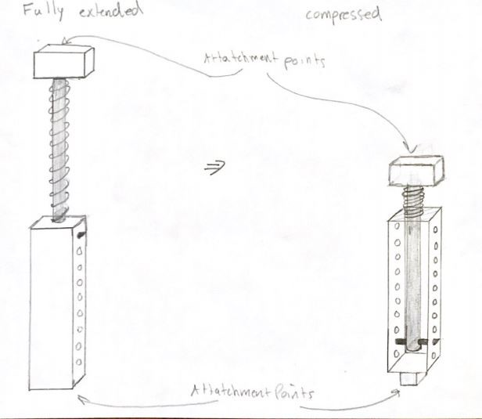
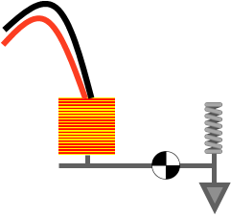
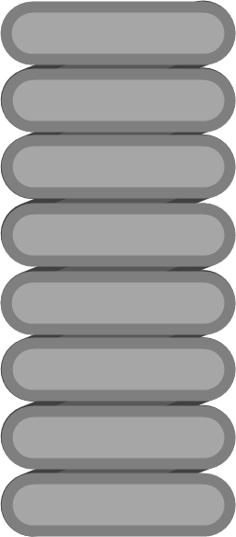
Concept Generation
Compressed
Extended
Ratchet
Solenoid
Locking Springs
Team 515
Con
Spring Pawl
Concept #7
Page 1/2
Matt Fowler

Slide 8
Concept Generation
Pawl Arm
Ferromagnetic Core
Linear Ratchet
Solenoid
To Lander
Main Spring
Extension Spring
Locking Springs
Team 515
Con
Concept #7
Page 2/2
Matt Fowler

Slide 9
Current Work
CAD
Geometric considerations
Material considerations
Fabrication considerations
Melanie Porter

Slide 10
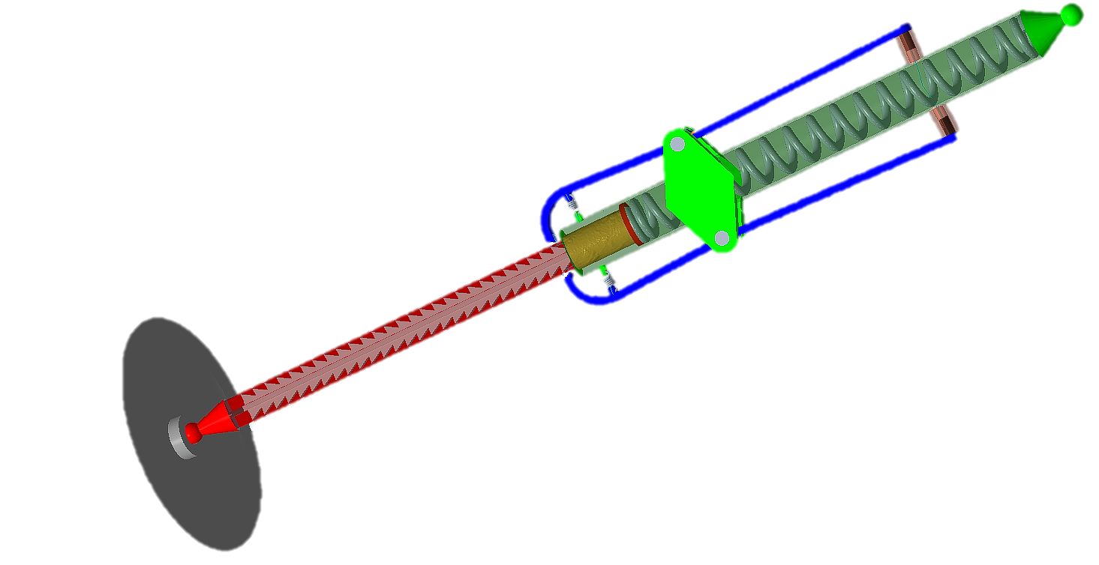
Geometric Considerations
Consideration
Pivot Point
Tooth Angle
Pawl Springs
Tooth Interface
Solenoid Force
Magnetic Field Generation
Pin Reaction Force
Tooth Reaction Force
Melanie Porter
10

Slide 11
Material Considerations
Springs
Structural Pieces
Wear Surfaces
Melanie Porter

Slide 12
Fabrication & Assembly
Circular I-beam and linear ratchet.
Circular I-beam is slid though top end before spring is loaded in.
Ball end of main cylinder threaded on.
Melanie Porter

Slide 13
Upcoming
Complete prototype designs
Determine testing methods and test prototypes
Prototype construction
Melanie Porter

Slide 14
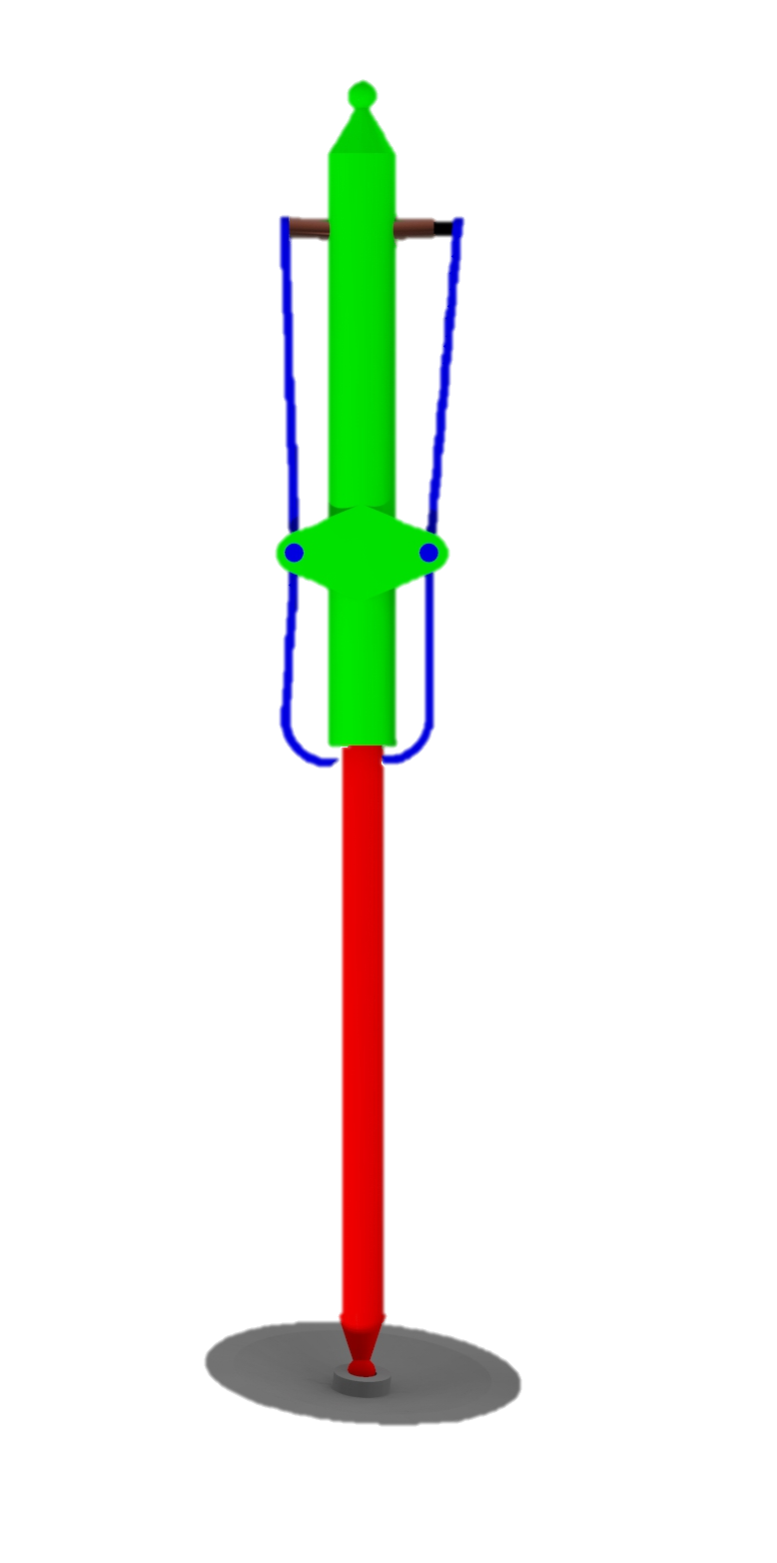
Prototype Construction
Melanie Porter

Slide 15
Prototype Testing
Five prototypes → four tests
Geometry
Spring
Pawl locking mechanism
Pawl releasing mechanism
Final prototype (not tested)
Melanie Porter

Slide 16
Thank You!
Notes:
It’s about the staff meeting

Slide 17
References
[1] Rodgers, W. F. (1972). Apollo Experience Report – Lunar Module Landing Gear Subsystem (NASA TN 0-6850). Washington , D.C. : National Aeronautics and Space Administration.
[2] INCO. (1974). Materials for Cryogenic Service: Engineering Properties of Austenitic Stainless Steels. Nickle Development Institute .

Slide 18
Backup Slides

Slide 19
Back Up Project Description

Slide 20
Back Up Functional Decomp
Functional Decomposition Cross Reference Table. Rows more important than columns
 | Withstand Shock | Support Weight | Absorb Impact Energy | Dampen Vibrations | Prevent Excessive Rebound | Transform Energy | Dissipate Energy | Store Energy | Return to Origingal State | Sum
Withstand Shock | - | 1 | 0 | 1 | 1 | 1 | 1 | 1 | 1 | 7
Support Weight | 0 | - | 0 | 1 | 1 | 1 | 1 | 1 | 1 | 6
Absorb Impact Energy | 1 | 1 | - | 1 | 1 | 1 | 1 | 1 | 1 | 8
Dampen Vibrations | 0 | 0 | 0 | - | 0 | 0 | 1 | 1 | 0 | 2
Prevent Excessive Rebound | 0 | 0 | 0 | 1 | - | 1 | 1 | 1 | 0 | 4
Transform Energy | 0 | 0 | 0 | 1 | 0 | - | 1 | 1 | 0 | 3
Dissipate Energy | 0 | 0 | 0 | 0 | 0 | 0 | - | 1 | 0 | 1
Store Energy | 0 | 0 | 0 | 0 | 0 | 0 | 0 | - | 0 | 0
Return to Origingal State | 0 | 0 | 0 | 1 | 1 | 1 | 1 | 1 | - | 5
Rank | 2 | 3 | 1 | 7 | 5 | 6 | 8 | 9 | 4
Rank | Function
1 | Absorb Impact Energy
2 | Withstand Shock
3 | Support Weight
4 | Return to Original State
5 | Prevent Excessive Rebound
6 | Transform Energy
7 | Dampen Vibrations
8 | Dissipate Energy
9 | Store Energy

Slide 21
Back Up Concept Selection: HoQ
 | Importance rating | Absorb Impact Energy | Absorb Structural Shock | Support Mass | Return to Original State | Indicate Reusability | Prevent Excessive Rebound | Transform Energy | Dampen Vibrations | Dissipate Energy | Store Energy | Withstand Lunar Conditions
The product can be used indefinitely. | 3 | 3 | 2 | 2 | 3 | 2 |  | 1 | 1 | 1 | 1 | 3
The product is lightweight. | 3
The product can be sent to the moon and used repeatedly. | 3 | 3 |  | 1 | 3 | 2 |  |  |  |  |  | 3
No routine maintenance is necessary during remainder of each lunar trip. | 1 |  |  |  | 2 | 1
Shock absorber dynamic qualities does not change or diminish after an impact. | 2 | 2 | 2 | 1 | 1 |  | 1 | 1 |  | 1 | 1
The product can handle an impact speed of 10 feet per second. | 3 | 3 | 3
The product can support 25,000 kg. | 2 |  | 3 | 3 |  |  | 2
The product can land at up to a 10-degree offset from the z-axis. | 1 |  |  |  |  |  | 1
Raw Score (total) | 146 | 31 | 21 | 17 | 21 | 13 | 7 | 5 | 3 | 5 | 5 | 18
Relative weight (%) | 100 | 21.23 | 14.38 | 11.64 | 14.38 | 8.90 | 4.79 | 3.42 | 2.05 | 3.42 | 3.42 | 12.33
Rank Order |  | 1 | 2 | 5 | 3 | 6 | 7 | 8 | 11 | 9 | 10 | 4

Slide 22
Back Up Concept Selection: Pugh 1
 |  | Concept
Selection Criteria | Datum | 1 | 2 | 3 | 4 | 5 | 6 | 7 | 8
Absorb Impact Energy | Apollo Shock Absorbers | - | s | + | + | + | s | + | s
Absorb Structural Shock |  | - | + | - | + | + | - | s | s
Support Mass |  | s | s | - | S | s | s | s | s
Return to Original State |  | + | + | + | + | + | + | + | +
Indicate Reusability |  | + | + | + | - | - | + | s | -
Prevent Excessive Rebound |  | - | - | + | + | + | + | + | +
Transform Energy |  | S | + | s | s | s | + | + | s
Dampen Vibrations |  | + | + | + | + | + | - | + | +
Dissipate Energy |  | s | + | s | s | s | + | s | s
Store Energy |  | s | s | s | + | s | + | + | s
Withstand Lunar Conditions |  | - | + | - | - | - | - | s | +
#of pluses |  | 3 | 6 | 5 | 6 | 5 | 6 | 6 | 3
# of minuses |  | 4 | 1 | 3 | 1 | 1 | 3 | 0 | 1

Slide 23
Back Up Concept Selection: Pugh 2
 | Concepts
Selection Criteria | Datum | 2 | 7 | 4
Absorb Impact Energy | Spider Legs | + | + | S
Absorb Structural Shock |  | + | + | +
Support Mass |  | s | + | -
Return to Original State |  | + | + | S
Indicate Reusability |  | s | - | +
Prevent Excessive Rebound |  | - | + | +
Transform Energy |  | + | + | +
Dampen Vibrations |  | - | + | +
Dissipate Energy |  | s | + | S
Store Energy |  | + | + | S
Withstand Lunar Conditions |  | s | + | -
#of pluses |  | 5 | 10 | 5
# of minuses |  | 2 | 1 | 2

Slide 24
Back Up Concept Selection: AHP 1
Criteria Matrix [c]
Customer Needs | Lightweight | Reusable | Dynamic qualities do not change after impact "hopping" | Reduce to <3Gs acceleration | Consistent tooling | handle impact 10ft/s | can support 25000kg | <10 degree offset from z axis
Lightweight | 1.00 | 0.33 | 0.33 | 0.20 | 3.00 | 0.14 | 0.20 | 0.33
Reusable | 3.00 | 1.00 | 3.00 | 0.33 | 5.00 | 0.20 | 0.33 | 3.00
Dynamic qualities do not change after impact | 3.00 | 0.33 | 1.00 | 0.20 | 3.00 | 0.20 | 0.20 | 0.33
Reduce to <3Gs acceleration | 5.00 | 3.00 | 5.00 | 1.00 | 5.00 | 0.33 | 0.33 | 3.00
Consistent tooling | 0.33 | 0.20 | 0.33 | 0.20 | 1.00 | 0.33 | 0.33 | 0.33
handle impact speed 10ft/s | 7.00 | 5.00 | 5.00 | 3.00 | 3.00 | 1.00 | 3.00 | 5.00
can support 32800kg | 5.00 | 3.00 | 5.00 | 3.00 | 3.00 | 0.33 | 1.00 | 5.00
<10 degree offset from z axis | 3.00 | 0.33 | 3.00 | 0.33 | 3.00 | 0.20 | 0.20 | 1.00
Sum | 27.33 | 13.20 | 22.67 | 8.27 | 26.00 | 2.74 | 5.60 | 18.00

Slide 25
Back Up Concept Selection: AHP 2
Normalized Matrix |  |  |  |  |  |  |  |  | {W}
Lightweight | 0.04 | 0.03 | 0.01 | 0.02 | 0.12 | 0.05 | 0.04 | 0.02 | 0.0403
Reusable | 0.1098 | 0.0758 | 0.1324 | 0.0403 | 0.1923 | 0.0729 | 0.0595 | 0.1667 | 0.1062
Dynamic qualities do not change after impact | 0.1098 | 0.0253 | 0.0441 | 0.0242 | 0.1154 | 0.0729 | 0.0357 | 0.0185 | 0.0557
Reduce to <3Gs acceleration | 0.1829 | 0.2273 | 0.2206 | 0.1210 | 0.1923 | 0.1215 | 0.0595 | 0.1667 | 0.1615
Consistent tooling | 0.0122 | 0.0152 | 0.0147 | 0.0242 | 0.0385 | 0.1215 | 0.0595 | 0.0185 | 0.0380
handle impact speed 10ft/s | 0.2561 | 0.3788 | 0.2206 | 0.3629 | 0.1154 | 0.3646 | 0.5357 | 0.2778 | 0.3140
can support 32800kg | 0.1829 | 0.2273 | 0.2206 | 0.3629 | 0.1154 | 0.1215 | 0.1786 | 0.2778 | 0.2109
<10 degree offset from z axis | 0.1098 | 0.0253 | 0.1324 | 0.0403 | 0.1154 | 0.0729 | 0.0357 | 0.0556 | 0.0734
Sum | 1 | 1 | 1 | 1 | 1 | 1 | 1 | 1 | 1.0000

Slide 26
Back Up Concept Selection: AHP 3
Weighted Sum Vector {Ws} | {W} | {Cons}
0.352 | 0.0403 | 8.737873 |  | n | 8
0.992 | 0.1062 | 9.337189 |  | lambda | 9.181082
0.488 | 0.0557 | 8.754142 |  | RI | 1.4
1.546 | 0.1615 | 9.571901 |  | CI | 0.168726
0.323 | 0.0380 | 8.492243 |  | CR | 0.120519
3.004 | 0.3140 | 9.567303
2.080 | 0.2109 | 9.863322
0.670 | 0.0734 | 9.124682
 | Average: | 9.181082

Slide 27
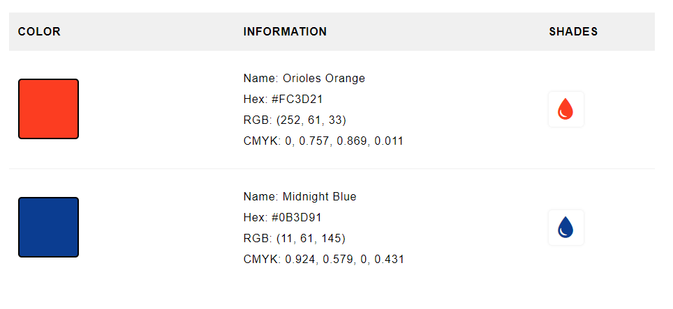
NASA Colors

Slide 28
Progress Trackers

